Slide 1
PLA Bluetooth Environment: A parametrized simulation
Michael Amista’ - Gabriel Rovesti
July 2nd, 2024
Supervisor: Alessandro Lotto
Advanced Topics in Computer Network and Security
2023-2024

Slide 2
Table of contents
Introduction to PLA & Related work
Overview of the project
Experiment & Implementation
FA (False Alarm) Study
MD (Miss Detection) Study
Conclusions + future works

Slide 3
Introduction to PLA
What is PLA?
Utilizes unique physical characteristics of the communication channel
Provides security by verifying the authenticity of the transmitter
Why this approach is promising:
Enhanced Security: Difficult for attackers to mimic physical properties
Low Overhead: No need for additional cryptographic algorithms
Real-Time Authentication: Quick verification process
Related works:
A lot of different studies overtime, mainly in Bluetooth Low Energy
More focused on discussing of Bluetooth vulnerabilities rather than proposing an effective authentication system

Slide 4
Overview of the project
Objective: Study the behavior of Bluetooth signals transmissions and receptions to develop a simulation environment to design and test Physical Layer Authentication (PLA) schemes.
Methodology:
We considered the transmission of binary signals between a transmitter and receiver, formed by an authentication key and data message.
We developed a decoding algorithm able to reconstruct the received signal and split it into the two packets (key and data).
We tested the strength of the decoding in classifying legitimate and not legitimate signals.

Slide 5
Experiment & Implementation
Experiment:
Study of the behavior of wireless signals in Bluetooth with parametrized transmissions
Implementation:
Combined data and authentication signals with different power levels based on the peaks as binary waveforms
Varied distance (1-50 meters) and SNR (10-30 dB) to represent realistic signal decay
Applied white noise (AWGN) to simulate channel effect
Tested fixed-threshold/variable-threshold decoding methods

Slide 6
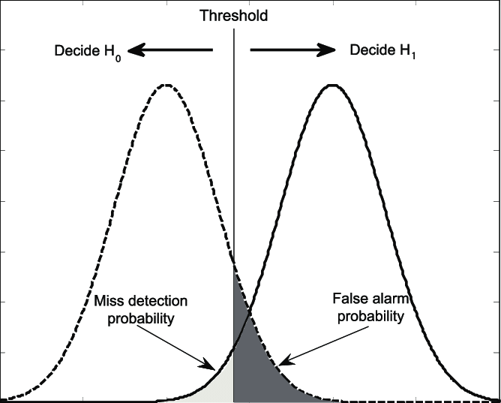
FA (False Alarm) Study
False Alarm: only authenticate messages are sent and check how many of those are interpreted as wrong (false negatives)
Parametrized simulation to test the transmissions:
Varied distance and SNR to test different configurations
Set error tolerance on key bits for authentication
Counted messages exceeding tolerance as false alarms
Source:
https://www.researchgate.net/figure/PDF-of-test-statistics-Miss-detection-and-false-alarm-cannot-be-reduced-simultaneously_fig1_252063675

Slide 7
FA (False Alarm) Study - Results
This simulation reported the following results:
Observed 0% false alarm rate across all distance-SNR pairs
Variable decoding algorithm effectively kept key bit errors below the set threshold
Results validated the effectiveness of the tolerance and the decoding algorithm chosen

Slide 8
MD (Miss Detection) Study
Miss Detection: only non-authenticate messages are sent and check how many of those are interpreted as legitimate (false positives)
Parametrized simulation to test the transmissions:
Varied parameters as previous configurations showed
Assumed realistic threat model: attacker having knowledge of channel parameteres and structure (MITM scenario)
Attacker trying to decode signal based on peaks similarly to legitimate receiver
Source:
https://www.researchgate.net/figure/PDF-of-test-statistics-Miss-detection-and-false-alarm-cannot-be-reduced-simultaneously_fig1_252063675

Slide 9
MD (Miss Detection) Study - Results
This simulation reported the following results:
Miss detection rates varies between 20% and 35% across simulations
Attacker unable to reconstruct messages perfectly due to partial knowledge of transmission powers
Results confirm the solidity of the decoding methods, able to detect good portions of invalid messages

Slide 10
Conclusions & Future Work
Final considerations:
Parametrized simulation demonstrates promise for real PLA schemes
Tested decoding methods proved more effectiveness in variable-threshold decoding methods, minimizing false alarms
Miss detection rates indicate room for improvement, further refining thresholds and decoding methods
Future development:
Noise-based simulation (additive noise) to improve MD performance
Filtering systems and improved auth techniques

